Slide 1
UpX Academy – Airlines Project
Bangalore Team
March 2017 Batch : Submitted May 2017
Notes:
This template can be used as a starter file to give updates for project milestones.
Sections
Right-click on a slide to add sections. Sections can help to organize your slides or facilitate collaboration between multiple authors.
Notes
Use the Notes section for delivery notes or to provide additional details for the audience. View these notes in Presentation View during your presentation.
Keep in mind the font size (important for accessibility, visibility, videotaping, and online production)
Coordinated colors
Pay particular attention to the graphs, charts, and text boxes.
Consider that attendees will print in black and white or grayscale. Run a test print to make sure your colors work when printed in pure black and white and grayscale.
Graphics, tables, and graphs
Keep it simple: If possible, use consistent, non-distracting styles and colors.
Label all graphs and tables.

Slide 2
Project Overview
Team
Airlines Dataset
Exploratory Data Analytical questions
Business Insights gained
Notes:
What is the project about?
Define the goal of this project
Is it similar to projects in the past or is it a new effort?
Define the scope of this project
Is it an independent project or is it related to other projects?
* Note that this slide is not necessary for weekly status meetings

Slide 3
Team
The project team consisted of :
Girish Pujar
Rajiv Ramanjani
Tanguturu Anjan Vijaya Kumar
Satish Godavarthi
Jayashree
Sujit
Vybhav
Praveen
Constance
Kiran
Notes:
* If any of these issues caused a schedule delay or need to be discussed further, include details in next slide.

Slide 4
Description of the Airlines Dataset
The Airlines Dataset consisted of data organized by the following fields:
Year, Month, Day, Departure Time, Scheduled Departure Time, Departure Delay, Arrival Time, Scheduled Arrival Time, Arrival Delay, Carrier, Flight, Tail Number, Origin, Destination, Air Time, Distance, Hour, Minute, Time Hour
Notes:
Duplicate this slide as necessary if there is more than one issue.
This and related slides can be moved to the appendix or hidden if necessary.

Slide 5
Exploratory Questions around Data Set
Which Airport has the highest arrival and departure delay and what is the comparison with other airports?
Which month of the year sees maximum delays?
Which hour of the day sees most delays?
Which Carrier has highest delay?
Top Eight Destinations with the lowest and highest arrival delays
What is the departure delays by airport?
What is the departure delays by carrier in EWR airport?
What is the departure delay trend by month?
Which airline has the highest number of flights? How does it compare to other airlines across each of the four quarters?
Which flight number has the highest movement in each of the airports and which flights have minimum movement?
Which tail number is used most by an airline? How does it compare with other airlines?
Which airline has flights that cover maximum? How does it compare to other airlines in different distance segments?
Notes:
The following slides show several examples of timelines using SmartArt graphics.
Include a timeline for the project, clearly marking milestones, important dates, and highlight where the project is now.

Slide 6
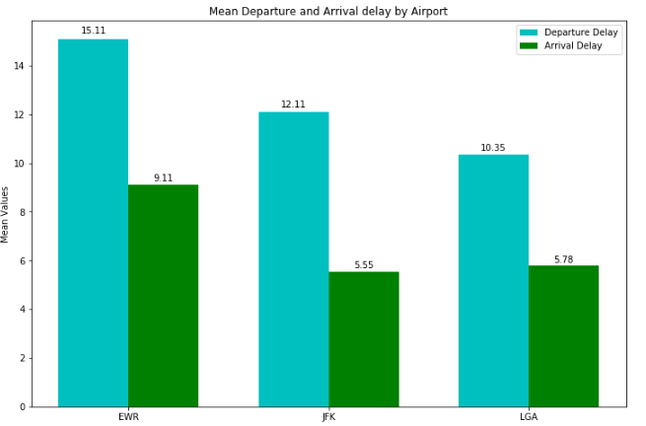
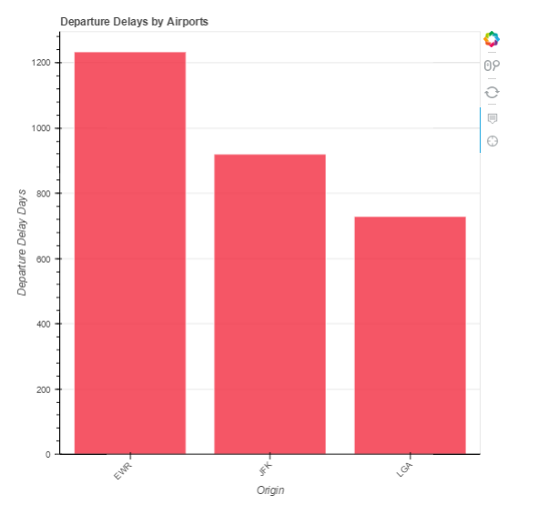
Airport with the highest arrival and departure delay and comparison with other airports
Insight:The Newark Liberty International Airport (EWR) has the highest arrival and departure delays – followed by John F Kennedy and then LaGuardia Airport

Slide 7
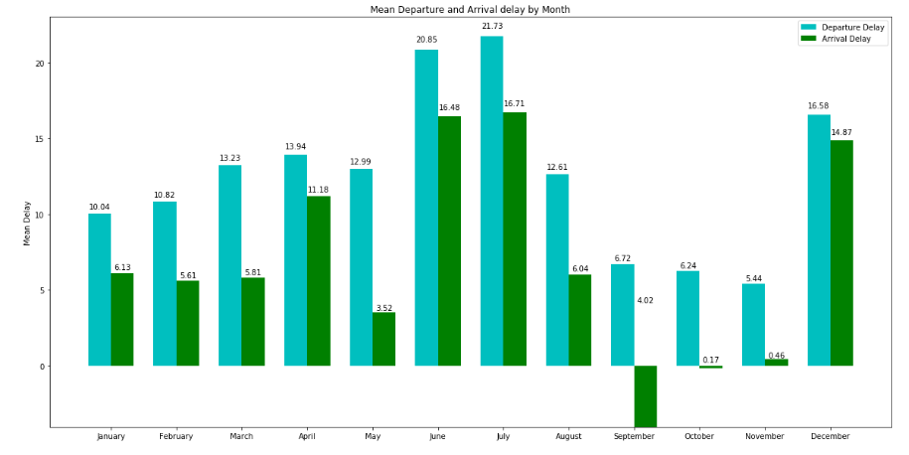
Month of the year with maximum delays
Insight: June, July and December seem to be the months with the highest delays. This could have to do with the fact that it is the peak vacation season in US

Slide 8
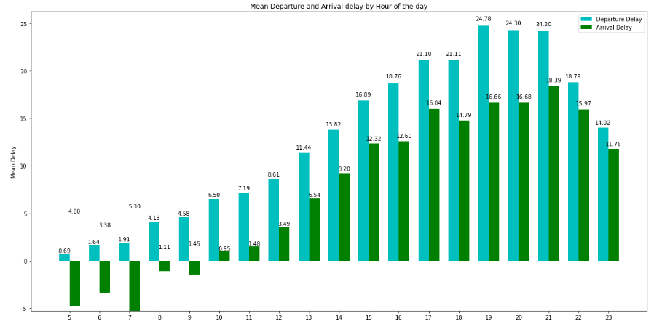
Hour of the day with most delays
Insight: Evening 1900 hrs is the time of the day with peak departure delays. This could have to do with the fact that traffic is very high as people could be leaving from work at that time of day

Slide 9
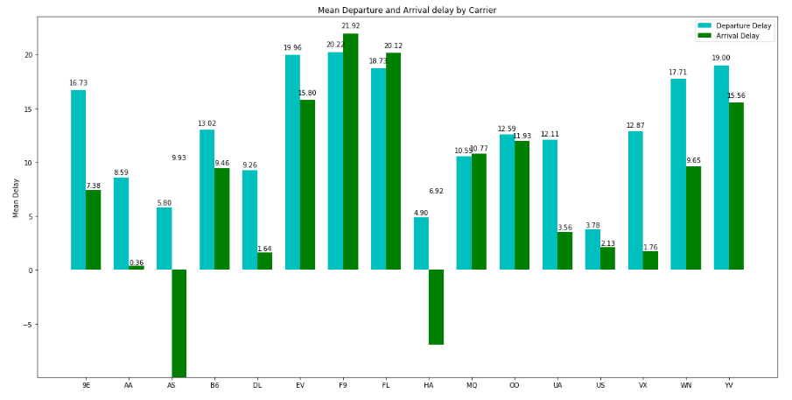
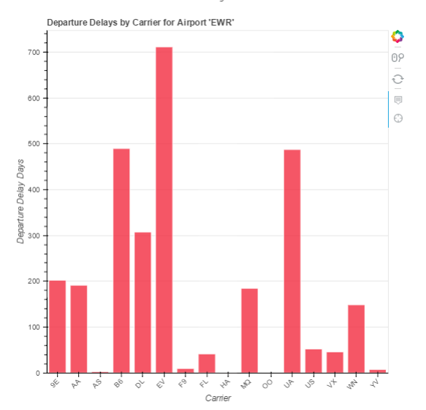
Carriers with highest delays
Insight: Carriers EV, F9, FL and YV have the highest delays whereas AS and HA airlines have the least delays. In EWR airport EV carrier has highest delays

Slide 10
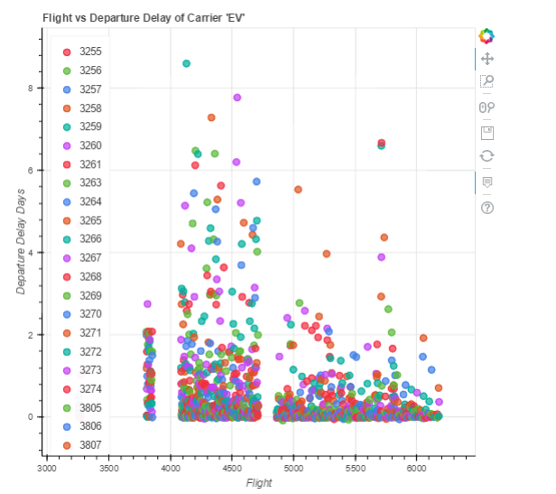
Trends for EV carrier

Slide 11
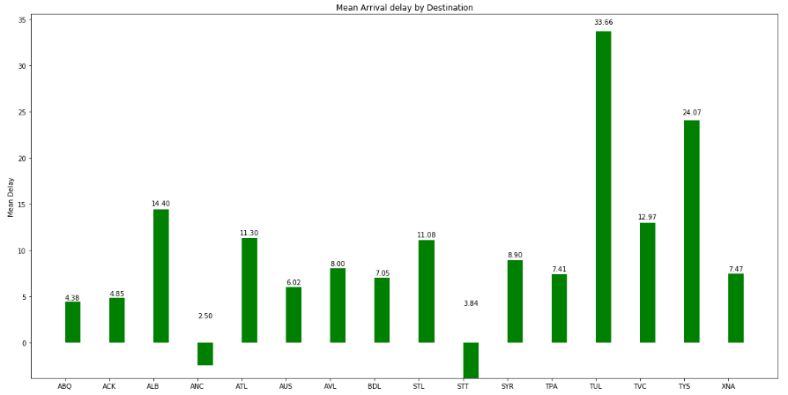
Arrival delays by destination
Insight: TUL, TVC and TYS are destinations with the highest arrival delay whereas ANC and STT are performing very well with least delay

Slide 12
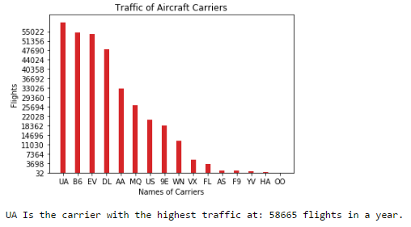
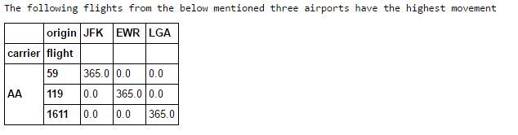
Carrier Traffic
Insight: While UA, B6, EV and DL carriers have the highest number of flights totally; specific flights that have the highest number of movement is for AA carrier with flight numbers 59, 119 and 1611 travelling daily from JFK, EWR and LGA airports

Slide 13
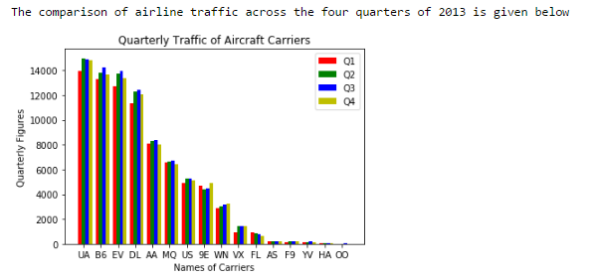
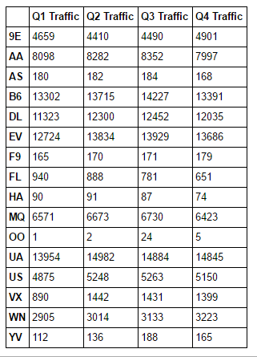
Airline traffic by carrier – across all four quarters
Insight: Carriers UA, B6, EV and DL have the highest traffic across all four quarters. Also Q1 seems to be lowest in terms of traffic. It could be due to lean tourist traffic as it comes after a peak vacation season (Q4) and before another peak season (Q2)

Slide 14
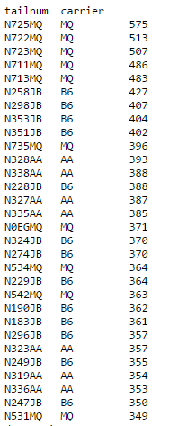
Tail numbers with highest movement
Insight: MQ and B6 carriers have the highest usage of the same tail number.

Slide 15
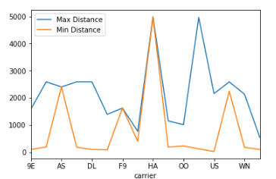
Airline flights that cover maximum distance
Insight: The HA carrier covers the maximum distance

Slide 16
Overall Insights
EWR : Newark Liberty International airport needs to do a better job of improving the delay times of flights flying from there.
They can start by addressing carriers EV, B6, UA and DL and try to focus on their carriers to improve their departure delay times
All three airports can be better organized to anticipate more traffic in June, July and December. By being better prepared they can reduce delays during these times of the year
Also more airline staff can be present in the day from the 1700 hrs to 2100 hrs segment. Since more people seem to travel during that time of the day – more streamlining of resources and provisioning of additional resources to tide over this peak surge may be introduced at that time.
Carriers UA and B6 – although having the highest number of traffic in a year – seem to be having a reasonably healthy delay time as compared to carriers EV, F9, FL and YV. There could be some best practices that the later could learn from the former in terms of controlling their delay times. Having said that B6 and UA don’t seem to be contributing well to the EWR airports overall delay times. EWR itself needs to do some deep dive as the reasons could be beyond the airlines control.

